Slide 1
Writing your personal statement: 10 rules for success
Margaret Diddams Ph.D.
Center for Scholarship and Faculty Development

Slide 2
Why a personal Statement?
You are joining a community
Contributing as well as enriching.
Can you communicate
Can you communicate a vision
Are you weird?

Slide 3
Is there a single approach?
From the Princeton Review. . . .
An experience that challenged or changed your perspective about medicine,
A relationship with a mentor or another inspiring individual,
A challenging personal experience,
An overview of your academic or life story,
An insight into the nature of medical practice.

Slide 4
Rules for Success I
Follow the instructions!

Slide 5
Rules for Success II
This is the opportunity for you to tell about your soft skills
Sincerity, maturity, empathy, compassion and motivation.
Are you capable of learning?

Slide 6
Rules for Success III
Keep it clear
Have one theme
Have appropriate transitions between paragraphs
Have it run through the essay
Close by coming back to the theme – concluding observation

Slide 7
Rules for Success IV
You are writing a story! This is not a narrative version of your resume
Pick something that is interesting to you so it will be interesting to your reader.
What makes a good story?
Theme
Plot
Structure
Character (you – anyone else?)
Style and tone
The best stories have a strong theme, a fascinating plot, a fitting structure, unforgettable characters, a well-chosen setting, and an appealing style.

Slide 8
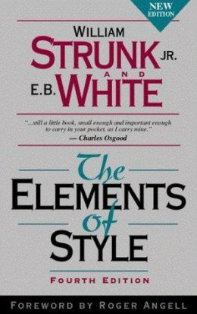
Rules for Success V
Omit needless words
Don’t get all flowery
Get to your points

Slide 9
Rules for Success VI
Tie it back to you and your career goals – remember this is an essay to get you into the health profession – what does this story have to do with telling them about yourself – it doesn’t necessarily need to end with “and that’s why I want to be a doctor.” – But it might and that’s ok!

Slide 10
Rules for Success VII
Differentiate Yourself
How does this story make you stand out

Slide 11
Rules for Success VIII
On the other hand
You are not God’s gift to medicine
Don’t tell prospective schools that their reputation will be even that more stellar as you will be the most outstanding graduate that they ever had.

Slide 12
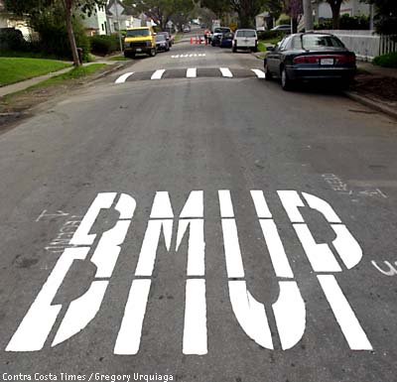
Rules for Success IX
Surface reading versus Deep Reading
You are reading for meaning and may have lost the ability to proof your own work.
Have someone brutally proof and give you feedback.

Slide 13
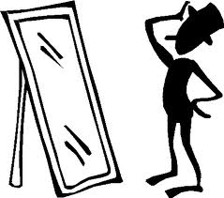
Rules for Success X
Mark 8:36 -- For what shall it profit a man, if he shall gain the whole world, and lose his own soul?
Write your own essay and be able to live with yourself.

