Slide 1
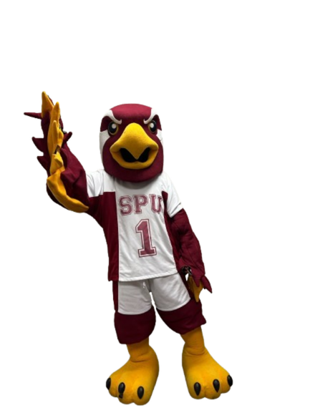

Seattle Pacific University +
EdSights
Launching
End of May 2026
Notes:
Option 2 without and added images from the partner.

Slide 2



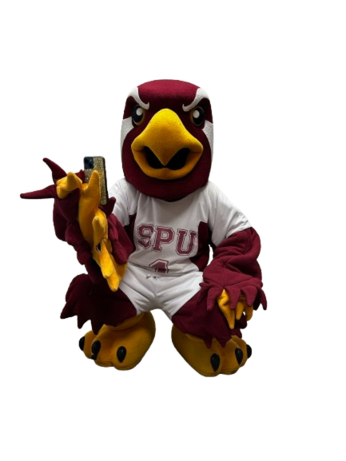
Meet TALON
Your friendly AI SMS chatbot
TALON is a chatbot that answers questions, checks in about your experience at SPU, and shares resources
Think of TALON as a "Siri" built for SPU
TALON also listens to your feedback and shares it with SPU

Slide 3



Text TALON for Immediate Help
TALON can answer your questions
This means that TALON responds 24/7 to any of your questions about SPU
How do I apply for scholarships?" to "What are the hours of the Library?"
Your question can be answered immediately - no lines or appointments needed

Slide 4
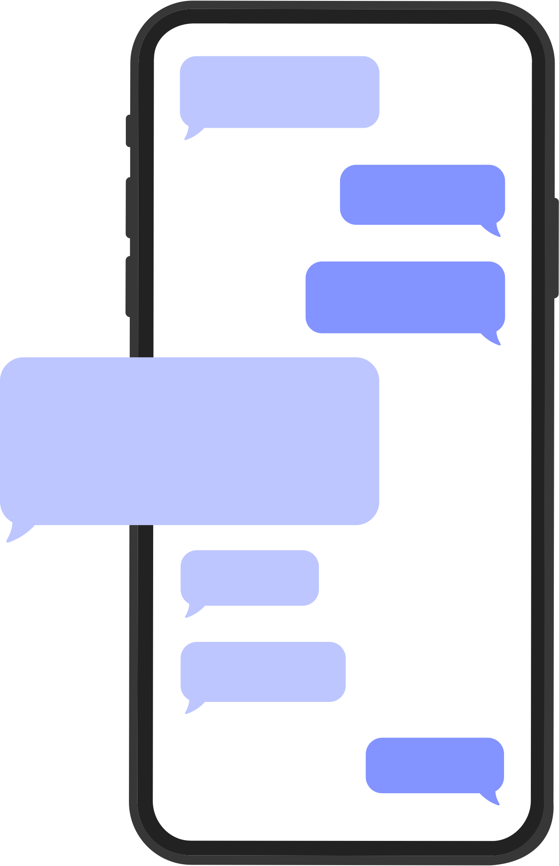




Let TALON Know How You're Doing
TALON checks in on you
TALON will initiate conversations with you every 7-10 days to understand how you are doing and any challenges you are facing.
Based on your need, TALON connects you to resources and staff members available at SPU.

Slide 5

1
TALON will reach out and share more information about the program
2
Text TALON your questions about SPU
What Comes Next
3
TALON will check-in with you throughout the year
4
Based on how you respond, TALON will connect you with helpful resources

Slide 6









RESPONSE TIME
KNOWLEDGE
Questions answered anytime, anywhere
Check out resources that meet your needs at SPU
CONNECTION
GROWTH
Why talk to TALON?
TALON is designed to reach out and support you
TALON learns about your needs and follows up with you
EFFICIENCY
HUMAN TOUCH
SPU's answers, right at your fingertips
SPU staff receive updates from TALON and may reach out with extra support

Slide 7

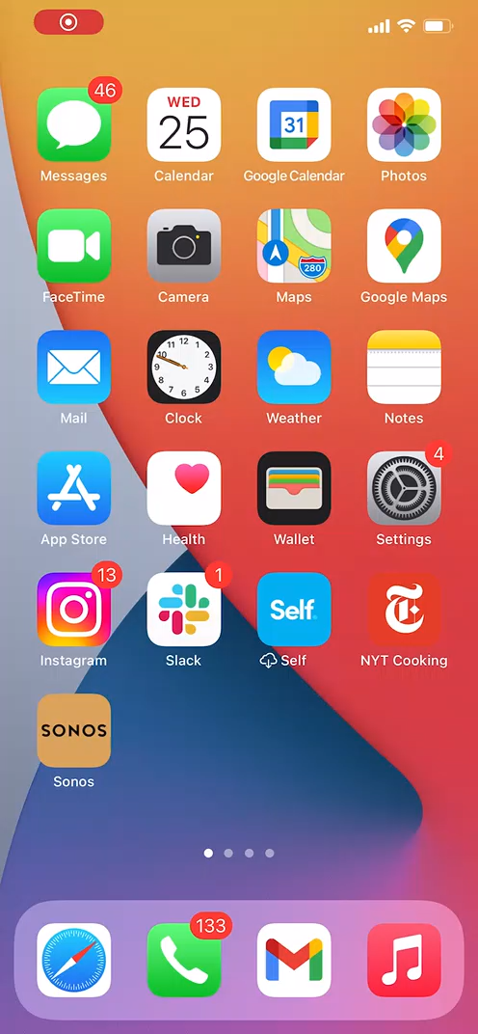
Example conversation between you and TALON
Questions about the chatbot? Contact John Hossler, Academic Operations: hosslerj@spu.edu
Notes:
PSM
This is an example of one of our proactive check-ins, where the bot checks in with a student to see how they are feeling.
This is Gus the Gorilla from Pittsburg State checking in with a student asking her how she is feeling about the start of the term.
She says she's nervous... that she's nervous because of academics... the bot digs a little bit deeper... you can see the first few questions were more structured like a multiple-choice which is a low barrier to entry for students, but then we ask for more open-ended feedback as the conversation goes on... You can see here the conversation "ended" but the student has a follow-up question, and the bot is able to react with an answer from the knowledge base... and then you say see that our bots also have a bit of a personality.
So what you just saw here is what's happening every week after we launch the chatbot; the bot is reaching out to students to see how they are doing and students are able to ask the bot questions.

