Slide 1
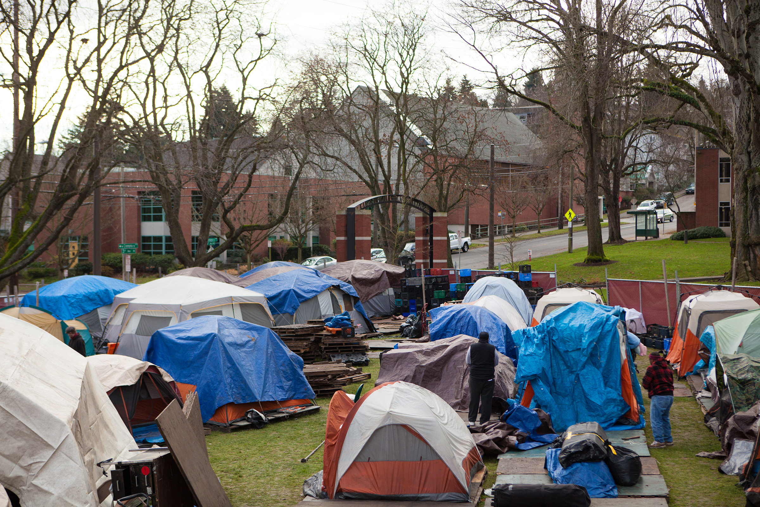
‘We are Homeless, not Helpless”: Voices from Inside a Tent Encampment
Karen Snedker & Jennifer McKinney
Department of Sociology
Seattle Pacific University
Karen Snedker & Jennifer McKinney
Department of Sociology
Seattle Pacific University

Slide 2
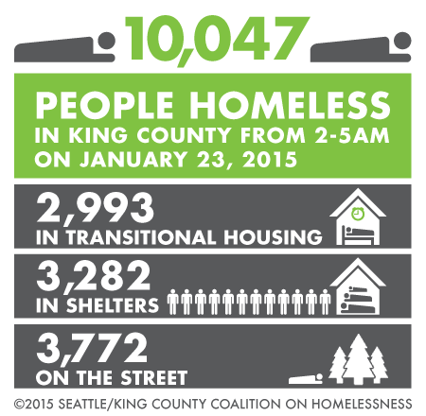
Homelessness in King County

Slide 3
Unsheltered in King County: One Night Count

Slide 4
Features of Tent Cities
What are tent cities?
General features
Collaboration
Code of conduct → “the rules”
Self-governance → “core values”
SPU host site for Tent City 3
2012 and 2014-2015
Interviews (N=34)

Slide 5
Who Lives in Tent City 3 (2015 data; n=24)
SEX | AGE | RACE | Education
Women – 25% | Range – 23-72 | White – 70% | <High School – 17%
Men – 75% | Mean – 47 | Black – 9% | High School – 17%
 | Median – 53 | Bi/Multi-racial – 13% | Some College – 57%
 |  | Latinx – 4% | College or more – 8%
 |  | Native American– 4%
Employment | Political Views | Religious Affiliation | Marital Status
Part-time – 9% | Conservative – 5% | Protestant – 24% | Never Married – 33%
Fulltime – 17% | Moderate – 9% | Catholic – 14% | Divorced – 58%
Seeking – 30% | Liberal – 27% | Buddhist – 5% | Married – 4%
Not seeking – 17% | Other – 59% | Other – 57%
Retired – 9% | (Anarchist, Libertarian, Radical, Revolutionary) | (Spirit-filled, Universalist, Agnostic) | 38% had children ranging from 2-50 years old
Time in Tent City 3
Range: 1 week-10 years | Mean: 1.9 years | Median: 27 weeks | Mode: 3 years
Time being homeless
Range: 3 weeks-23 years | Mean: 6 years | Median: 5 weeks | Mode: 5 years

Slide 6
Tent Cities as an Alternative
Streets and shelters
Unsafe
Health and well-being
Tent cities in comparison
Safe
Co-ed/couples
Agency
Ownership
Work

Slide 7
Homelessness & Tent City 3
Similarities → economic and limited social support
Differences
Drugs, alcohol and mental illness
Appearance
“Houseless”/“Roofless”
Stereotypes → debunking
and reinforcing

Slide 8
Building Community @ TC3
Relationships and sociability
Safety → it’s the community that keeps them safe
Self-governance/democracy
Challenges to community
Turnover
Time
Rules (barring, power, and politics)

Slide 9
Policy Implications
Expand outreach and social services to tent encampments → not transitional
Advocacy
Build on community and organization →
communal living
Subsidized housing with
tenant associations

Slide 10
